Slide 1
THE IMPACT OF EDUCATION ON CHILD MARRIAGE
SHIBANI
LEON
OLIVIA
HEPHZIBAH
University of Toronto School of Continuing Studies – Data Analytics Bootcamp 2020

Slide 2
Data Questions
Question 1
Is child marriage decreasing over time?
Question 2
What is the correlation of literacy rate and child marriage?
Question 3
What is the geographical impact on child marriage and education?
Question 4
Is one gender more susceptible to child marriage than the other?
Notes:
Child marriages, as defined by UNICEF, are those undertaken by men or women under the age of 18 and include unions where a woman and a man live together as if they were married.
Many factors interact to place a child at risk of marriage, including poverty, the perception that marriage will provide ‘protection’, family honor, social norms, customary or religious laws that condone the practice, an inadequate legislative framework and the state of a country’s civil registration system.

Slide 3
Data Sources
Child Marriage Dataset from UNICEF
Education Dataset from World Bank
Countries dataset
Google Maps API
World Bank API

Slide 4
Assumptions
Percentage of women married or in union before age 18 and before age 15 is not the same.
The correlation developed for this project assumes that other factors affecting child marriage such as the socio-economic factors, the GDP of the country and its population, the religious belief system and other such factors are equal.

Slide 5
Flow Chart
Data Search
Identifying the data sets that would be used for analysis. Developing questions for analysis forming project proposal.
Data Analysis
Conducting analysis through narrowing down scope to try and answer specific questions pertaining to the data sets.
Stage 2
Stage 4
Stage 1
Stage 3
Data Munging/Cleaning
Exporting the data sets into Pandas, cleaning it and formatting it into data tables to ensure optimal efficiency for analysis.
Presentation
Visually represent the data in graphs, charts, heat maps and regression lines to try represent key findings in an optimal manner.

Slide 6
Data Munging Process
Step 1
Step 2
Step 3
Exploring raw data trying to identify improvement areas
Removing specific columns and rows irrelevant to the purpose of analysis
Rename columns to more descriptive names
Merge certain datasets to ease analysis
Drop any null values that are meaningless to analysis
Identifying the specific functions to perform the cleaning
Reasoning the best type of join for merging in order to maintain data quality and integrity
Standardize format of key column to integrate data sets seamlessly (changed to lowercase string)
Creating new data frames containing the clean data
Looking over the clean data tables to verify data is clean and prepared for analysis
Count rows in data tables to ensure we haven’t lost a significant amount data while cleaning

Slide 7
Extracting Data
CHILD MARRIAGE DATASET:
Percentage of women (aged 20-24 years) married or in union before age 18
Percentage of women (aged 20-24 years) married or in union before age 15
Percentage of men (aged 20-24 years) married or in union before age 18
EDUCATION DATASET:
The literacy rate was chosen as the indicator for education dataset
COUNTRIES DATASET:
For information of Latitude and Longitude for each country

Slide 8
Data Merging
Used Inner join
Merged Education data set with countries data set ON countries
Merged Child Marriage data set with countries data set ON countries
This allowed us to get the latitude and longitude values in each data set

Slide 9
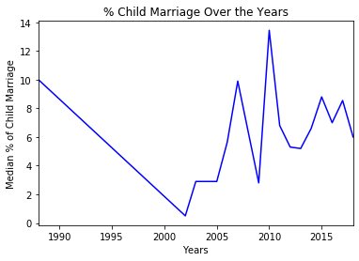
Question 1: Is child marriage decreasing over time?
Notes:
Drastic drops and rises in the graph indicating lack of data in certain years for some countries which is essentially skewing the median calculation
This analysis showed us that it might be more insightful to create ranges of the years to try and identify a trend in the data and avoid the significant drops and rises

Slide 10
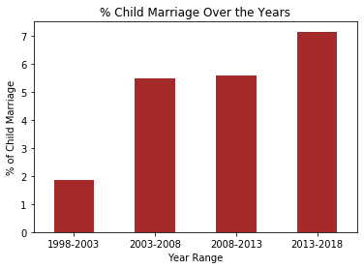
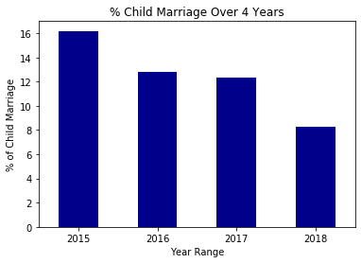
Question 1: Is child marriage decreasing over time?

Slide 11
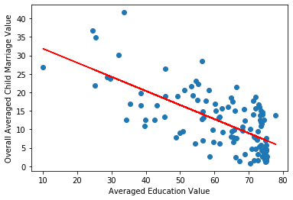
Question 2: What is the correlation of literacy rate and child marriage?
y = -0.38155x + 35.65
r-squared = -0.6880431291174198

Slide 12
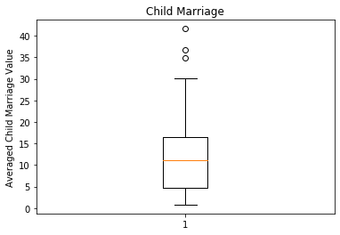
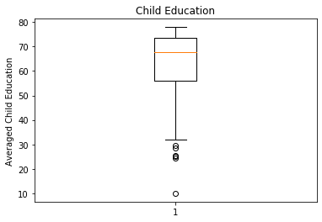
Question 2: What is the correlation of literacy rate and child marriage?
OUTLIERS:
Central African Republic (41.63),
Chad (34.86),
Niger (36.66)
OUTLIERS:
Burkina Faso (25.20),
Chad (25.40),
Guinea (28.70),
Mali (29.71),
Niger (24.50),
Somalia (10.03)

Slide 13
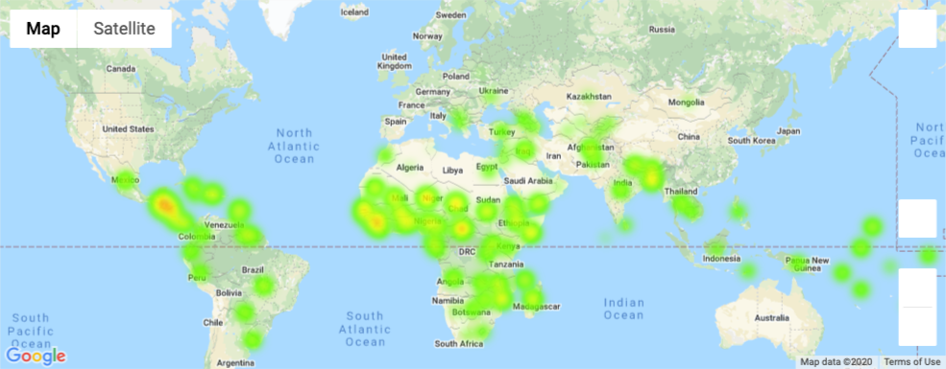
Question 3: What is the geographical impact on child marriage and education?
Child Marriage

Slide 14
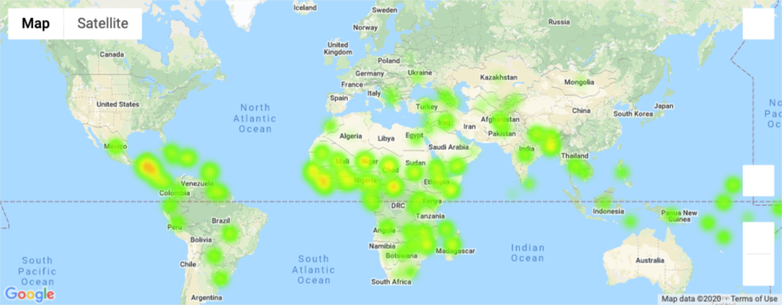
Question 3: What is the geographical impact on child marriage and education?
Literacy rate

Slide 15
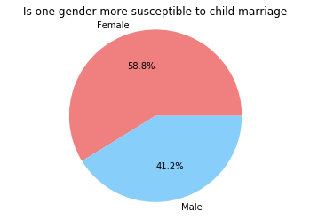
Question 4: Is one gender more susceptible to child marriage than the other?
Notes:
To provide a non-biased distribution of the genders susceptible to child-marriage, only the indicators of child marriage for men and women below 18 were considered.

Slide 16
Null and Alternative Hypothesis
When calculating the p-value; we chose to calculate the statistical significance of two populations:
countries with low education/child marriage rates
countries with high education/child marriage rates
As the p-value is lower than our statistical significance of 5%, we therefore reject the null hypothesis that literacy rate has no effect on child marriage rates.
P-Value = 1.835636112113863e-09

Slide 17
Null and Alternative Hypothesis When income levels are equalised
When calculating the p-value; we chose to calculate the statistical significance of two populations under same income level:
countries with low education/child marriage rates
countries with high education/child marriage rates
As the p-value is lower than our statistical significance of 5%, we therefore reject the null hypothesis that education rates has no effect on child marriage rates.
P-Value =0.0433899523717

Slide 18
Questions

